Slide 1
RSA Cryptography
An Aquatic Chill & Chat
Thomnas Swayze
September 24, 2020
https://github.com/teswayze/rsa

Slide 2




Communication over an insecure channel
You look very cute in your overalls

Slide 3
Text Cipher
LBHYBBXIRELPHGRVALBHEBIRENYYF
You look very cute in your overalls
YOULOOKVERYCUTEINYOUROVERALLS
LBHYBBXIRELPHGRVALBHEBIRENYYF
LBHYBBXIRELPHGRVALBHEBIRENYYF

Slide 4
Text Cipher
Each letter in the message is replaced with a different letter according to some predefined permutation
Example:
ABCDEFGHIJKLMNOPQRSTUVWXYZ
NOPQRSTUVWXYZABCDEFGHIJKLM
Both Alice and Bob must know the cipher key and must keep it a secret from Eve
Vulnerable to a frequency analysis attack
Homophonic substitution: expands the encryption alphabet and assigns frequent letters multiple values
Polyalphabetic substitution: the permutation key rotates after each position
Polygraphic substitution permutes blocks of letters at a time

Slide 5
Polyalphabetic Cipher Example
Choose a key word
For this example – AQUATIC
Repeat the key word as many times as necessary to cover the length of the string
YOULOOKVERYCUTEINYOUROVERALLS
AQUATICAQUATICAQUATICAQUATICA
Use the letter from the message and the letter from the repeated key word to look up the letter of the cipher
YEOLHWMVULYVCVEYHYHCTOLYRTTNS

Slide 6
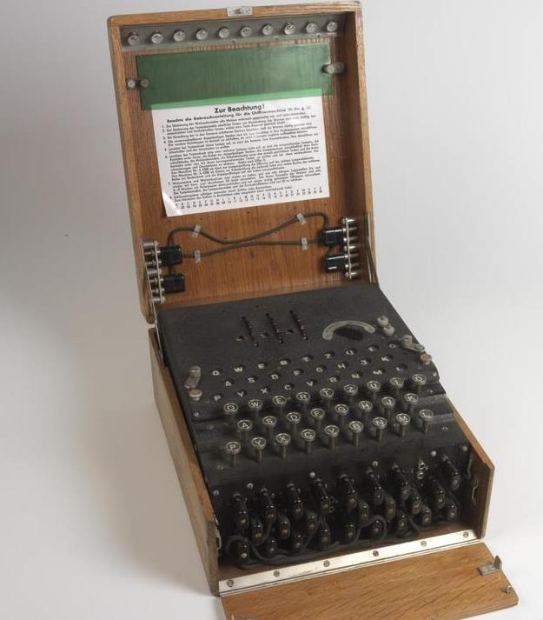
German Enigma Machine
Used by the Germans during World War II
Polyalphabetic cipher
Mechanical device cycled through different cipher permutations for each letter
Encryption method is its own inverse
No letter is mapped to itself

Slide 7
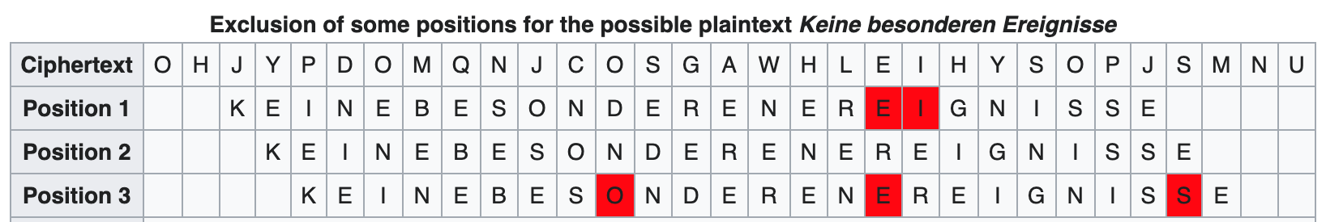
Attacks on German Enigma
Poland’s Marian Rejewski discovered mathematical tricks to reduce the search space
Alan Turing and others at Bletchley Park scaled the efforts when the Germans added complexity
Search for possible occurrences of likely messages in encoded text
Expected messages are called “cribs”
Try to decrypt with possible keys (machine wiring was known) until the “cribs” were found
Cryptographers could reduce the search space by using the fact that no letter is mapped to itself
Some cribs were known to occur at the beginning of the cipher text

Slide 8
Cribs Used to Attack Enigma
“One” – eins
“To” - ANX
“Nothing to report” - Keine besonderen Ereignisse
“To the group” - An die Gruppe
“Weather survey 0600” - WEUBYYNULLSEQSNULLNULL
Continuation messages – FORTYWEEPYWEEPY
Formal greetings
Messages sent on another cipher network
Retransmission of messages by double agents
LLLLLLLLLLLLLLLLLLLLLLLLLLLLLLLLLLLLLLLLLLLLLLLLLLLLLLLLLLLLLLLLLLLLLLLLLLLLLLLLLLLLLLLLLLLLLLLLLLL…

Slide 9
Specifications for public key cryptography
Alice relays her message to Bob through a series of back and forth communications
No pre-arranged secrets allowed
Alice and Bob’s encryption / decryption calculations need to be very fast
Eve must have no computationally feasible way of recovering the message after viewing the communications
Eve may have orders of magnitude more resources than Alice and Bob do
Usually done by ”some clever math trick”

Slide 10

Modular Congruences
Let $a$, $b$, and $n$ be integers with $n>0$. We say that $a$ is congruent to $b$ modulo $n$ if $n$ divides $a−b$.
Denote this as a $a≡b \left(mod n\right)$
For a fixed $n$, this divides the integers into $n$ groups (equivalence relation)
Examples:
Odd numbers ($n=2$)
Multiples of 3 ($n=3$)
Numbers with a last digit of 7 ($n=10$)
Numbers that are 2 more than a multiple of 11 ($n=11$)

Slide 11

Modular Addition
Theorem: if $a≡b \left(mod n\right)$ and $c≡d \left(mod n\right)$, then $a+c≡b+d \left(mod n\right)$
Proof: If $n$ divides $a−b$ and $c−d$, then $n$ divides $\left(a−b\right)+\left(c−d\right)=\left(a+c\right)−\left(b+d\right)$
Example:
Even + Even = Even; Odd + Odd = Even; Even + Odd = Odd
To find the last digit of the sum of two numbers, just add the last digits
Modular addition is commutative and associative
Zero is the identity of addition
The inverse of $a$ modulo $n$ is $−a$

Slide 12

Modular Multiplication
Theorem: if $a≡b \left(mod n\right)$ and $c≡d \left(mod n\right)$, then $ac≡bd \left(mod n\right)$
Proof: If $n$ divides $a−b$ and $c−d$, then $n$ divides $c(a−b)+b\left(c−d\right)=ac−bd$
Example:
Even * Even = Even; Odd * Odd = Odd; Even * Odd = Even
To find the last digit of the product of two numbers, just multiply the last digits
Modular multiplication is commutative and associative
Zero is the identity of multiplication

Slide 13

Modular Multiplicative Inverse
Theorem: if $a$ has no common factor with $n$, then $a$ has a multiplicative inverse modulo $n$
“Proof” by example: let $a=7$ and $n=100$
We want to find $b$ such that $7b≡1 \left(mod 100\right)$
Find integers $b$and $k$so that $7b+100k=1$
Reduce 100 modulo 7: 100 = 7*14 + 2
Reduce 7 modulo 2: 7 = 3*2 + 1
Put it together: 1 = 7 – 3*2 = 7 – 3*(100 – 7*14) = 7*43 – 3*100
The inverse of 7 modulo 100 is $b=43$
This is a modified version of the Euclidean algorithm
You can only get stuck if the two numbers share a common factor
Runs in logarithmic time

Slide 14
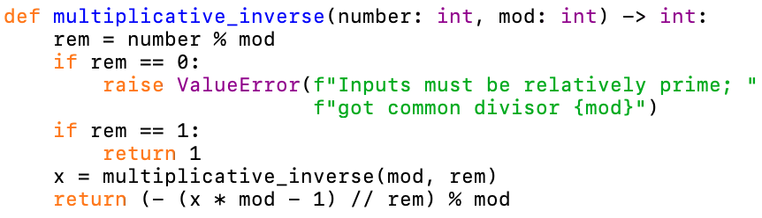

Modular Multiplicative Inverse Algorithm
By recursion, x * mod $≡$ 1 (modulo rem)
Let y = (1 - x * mod) / rem
Note that y is an integer
Then y * rem + x * mod = 1
So y * number $≡$ y * rem $≡$ 1 (modulo mod)

Slide 15

Modular Exponentiation
Theorem: if $a≡b \left(mod n\right)$ and $c$ is a positive integer, then $ac≡bc \left(mod n\right)$
Proof: Use the multiplication theorem many times
You can’t reduce the exponent mod $n$
Counterexample:
$4≡1 (mod 3)$
$24=16≢2=2^{1} \left(mod 3\right)$

Slide 16

Example: What is the last digit of 7⁷⁷?
$72=49≡9 \left(mod 10\right)$
$73=72∗7≡9∗7=63≡3 \left(mod 10\right)$
$74=73∗7≡3∗7=21≡1 \left(mod 10\right)$
$75=74∗7≡1∗7=7 \left(mod 10\right)$
$76=75∗7≡7∗7=49≡9 \left(mod 10\right)$
$77=76∗7≡9∗7=63≡3 \left(mod 10\right)$
A pattern appears: the powers of 7 modulo 10 repeat every 4 iterations
We can reduce the exponent modulo 4
$77≡1 \left(mod 4\right)$
$777=71=7 (mod 10)$

Slide 17

Fermat’s Little Theorem
Theorem (Fermat, 1640): if $a$ is an integer and $p$ is prime, then $ap≡a (mod p)$
As a result, if $p$ is prime, then to compute $ab$ modulo $p$, we can reduce $a$ modulo $p$ and $b$ modulo $p−1$
Not to be confused with Fermat’s Last Theorem
Conjectured by Fermat in 1637
States that $xn+y^{n}=z^{n}$ has no solutions for $n≥3$ and $x,y,z>0$
Published in the margin of a paper, as the margin was not long enough to contain the proof
Fermat died shortly after
Was finally proven in 1994 with techniques not available at the time

Slide 18

Proof of Fermat’s Little Theorem
We count the number of necklaces that can be formed using $n$ beads of $a$ different colors
Rotations of the same necklace should only be counted once
Naïve counting method: there are $a^{n}$ necklaces
The fails because it counts some configurations more than once
The amount of times each necklace is counted must be a divisor of $n$

Slide 19

Proof of Fermat’s Little Theorem
In the case where $n=p$ is a prime number, each necklace is either counted $p$ times or counted once
Because the only factors of $p$ are 1 and $p$
Example with $p=5$ and $a=2$:
AAAAB AAABA AABAA ABAAA BAAAA
AAABB AABBA ABBAA BBAAA BAAAB
AABAB ABABA BABAA ABAAB BAABA
AABBB ABBBA BBBAA BBAAB BAABB
ABABB BABBA ABBAB BBABA BABAB
ABBBB BBBBA BBBAB BBABB BABBB
AAAAA
BBBBB

Slide 20

Proof of Fermat’s Little Theorem
The only necklaces that are counted once are monochromatic
There are $a$ of these
All other necklaces are counted $p$ times
The number of naïve configurations that are not monochromatic is $a^{p}−a$
There are $\frac{a^{p}−a }{p}$ non-monochromatic necklaces
This had better be an integer!
We conclude that $a^{p}≡a (mod p)$

Slide 21

Consequences of Fermat’s Little Theorem
To compute $ab$ modulo $p$, we can reduce $a$ modulo $p$ and $b$ modulo $p−1$
If $a$, $d$ and $e$ are integers such that $de≡1 (mod p−1)$, then ${{(a}^{e})}^{d}≡a (mod p)$
We can ”undo” certain exponentiations modulo $p$
If $e$ shares no common factor with $p−1$, then we can take $d$ to be the multiplicative inverse of $e$ modulo $p−1$
This is not quite good enough for cryptography yet
It is too easy to recover $d$ from $p$ and $e$

Slide 22

Exponentiation modulo semiprimes
Let $p$ and $q$ be two distinct primes, and let $n=pq$
We say that $n$ is ”semiprime”
For any integer $a$ not divisible by $p$ or $q$, notice that $a^{lcm(p−1, q−1)}$ is both one more than a multiple of $p$ and one more than a multiple of $q$
Therefore, it is one more than a multiple of $n=pq$
When doing exponentiation modulo $n$, we can reduce the exponent modulo $m=lcm(p−1,q−1)$
If $de≡1 \left(mod m\right)$, we have that ${{(a}^{e})}^{d}≡a (mod n)$ for all integers $a$
It is very easy to recover $d$ from $p$, $q$, and $e$, but if we only know $n$ and $e$, it’s much harder!

Slide 23

RSA Cryptography Procedure
Bob must generate the key:
Select two large prime numbers $p$ and $q$, and set $n=pq$
Set $m=lcm(p−1,q−1)$, and choose $e$ relatively prime to $m$
A popular choice is $e=65537=2^{16}+1$
Compute $d$ as the multiplicative inverse of $e$ modulo $m$
The pair $(n,e)$ is published as a public key, but $d$ kept secret
To encrypt a message $x$, Alice computes $x^{e}$ modulo $n$
To decrypt a message $y$, Bob computes $y^{d}$ modulo $n$
Because $de≡1$ modulo $m$, $(x^{e})^{d}≡x$ modulo $n$

Slide 24
Alice and Bob use RSA
P=61
Q=53
N=3223
M=780
E=17
D=413
X=65
N=3223
E=17
Y=2790
N=3223
E=17
Y=2790
N=3223
E=17
Y=2790

Slide 25

Can Eve recover X from N, E, and Y?
If a certain open mathematical conjecture holds, recovering x from n, e, and y is “as hard” as factoring n into p and q
By “as hard”, we mean that there’s a polynomial (in log(n)) time algorithm that can solve one problem using a solution to the other
The mathematical result is the Extended Riemann Hypothesis
The best known algorithm for factoring n into primes is the general number field sieve
Runs in time $exp⁡(c∗{ln⁡(n)}^{1/3}∗{ ln⁡(\ln\left(n\right))}^{2/3})$
Largest number n ever factored has 250 digits
A quantum computer can factor integers in polynomial time
Quantum computer’s using Shor’s algorithm have factored semiprimes as high as 291,311 = 523*557

Slide 26

Are Alice and Bob’s computations fast?
Computing $a^{b}$ modulo $n$ can be done in time $O(\log\left(b\right)∗\log\left(n\right))$
The power $a^{b}$ can be computed by doing $O(\log\left(b\right))$ multiplications
By reducing after every step, each multiplication involves two integers less than $n$
By using the fast multiplicative inverse algorithm, Bob can compute $d$ from $p, q, e$ in $O(log\left(n\right))$ time
What about generation of primes?
Need a fast algorithm for checking primality
Has to be much, much faster than factoring the primes

Slide 27

Fermat’s Primality algorithm
Given a positive integer $n$, we want to check if $n$ is prime
Pick some integer $a<n$
Compute $a^{n}$ modulo $n$
If $a^{n}≡a$ modulo $n$, $n$ may be prime
Otherwise, we know that $n$ is composite
Testing multiple values of $a$ can increase the accuracy of the test
341 = 11*31 is not prime
$2^{341}≡2$ modulo 341
341 is called a pseudoprime to base 2
$3^{341}≡168$ modulo 341
3 is a witness to the compositeness of 341

Slide 28

Carmichael numbers
For every integer $a<561$, $a^{561}≡a$ modulo 561
But 561 is not prime!
561 = 3 * 11 * 17
Numbers with this property are called Carmichael numbers
Have the property that if $p$ divides $n$, then $p−1$ divides $n−1$
There are infinitely many of them
Fermat primality test has no way of spotting Carmichael numbers, no matter how many values of $a$ you try

Slide 29

Miller-Rabin Primality test
Write $n−1$ as $2^{r}∗k$, where $k$ is odd
Compute the $r+1$ element sequence $a^{k},a^{2k},a^{4k},…,a^{n−1}$ modulo $n$
If the last element of the sequence is not 1, $n$ is composite
This is the same as the Fermat primality test
If the sequence is not all 1’s, the last non-1 element of the sequence should be $n−1$. If this is not the case, $n$ is composite.
Otherwise, $n$ might be prime

Slide 30

Miller-Rabin Primality test Example
Let $n=561$, $a=2$
Write $560=2^{4}∗35$
Compute $2^{35},2^{70},2^{140},2^{280},2^{560}$ modulo 561
$2^{35}≡263$ modulo 561
$2^{70}≡166$ modulo 561
$2^{140}≡67$ modulo 561
$2^{280}≡1$ modulo 561
$2^{560}≡1$ modulo 561
Since $67≠560$ precedes 1 in the sequence, 561 is not prime

Slide 31

Why Miller-Rabin works
In this example, we found:
$2^{140}≡67$ modulo 561
$2^{280}≡1$ modulo 561
This means that ${67}^{2}≡1$ modulo 561
Therefore, 561 divides ${67}^{2}−1=\left(67−1\right)∗\left(67+1\right)=66∗68$
If 561 were prime, it would have to divide either 66 or 68
This is impossible, so 561 is composite
We can find a factor of 561 by computing the gcd of 66 and 561

Slide 32

Miller-Rabin accuracy
If we run Miller-Rabin with $a=2,3,5,7,11$, we will identify all composite numbers less than 2,152,302,898,747
For any given composite number, a randomly chosen base $a$ will identify compositeness at least 75% of the time
By testing more and more values of $a$, we can verify that a number is prime with whatever certainty is required
If the Extended Riemann Hypothesis holds, testing all values of $a$ up to ${log⁡(n)}^{2}$ mathematically guarantees finding all composite numbers

Slide 33

Performance of key generation
We randomly pick a candidate prime $p$ of the desired size and check if it’s prime using the Miller-Rabin test
Each iteration of the Miller-Rabin test takes $O({\log\left(p\right)}^{2})$ time to run
Only check a constant number of times per candidate prime to get required accuracy
According to the density of the primes, the average number of primes you need to check is $O(\log\left(p\right))$
We can generate keys very rapidly, even with very large semiprimes that are too large to factor

Slide 34

Use to sign messages
Bob can sign a message x by communicating $y≡x^{d}$ modulo $n$
Alice can verify this by checking that $x≡y^{e}$ modulo $n$
Anyone can use the pair $\left(n,e\right)$ to verify the signature, but nobody can reproduce it to impersonate Bob

Slide 35

Attacks/Gotchas
The semiprime $n$ can be easily factored if the primes $p$ and $q$ are two close together
If insecure randomness is used, the number of possible primes is much smaller than you might expect
There are over $2^{324}$ primes with fewer than 100 digits
Python’s random library uses a 32-bit integer as a seed
You can run the Euclidean algorithm on two semiprimes to quickly check if they share a factor
If you encode the same message using the same value of $e$ and $e$ different values of $n$, a hacker can recover the message
If there are very few possible messages, a hacker can use the encryption algorithm to guess-and-check for Alice’s message
Random padding can help with many of these problems, but some padding schemes are insecure
For example, multiplying the message by $2^{k}$ and adding $k$ bits of randomness does not secure the message

Slide 36
Obligatory ”EARN IT is stupid” slide
EARN IT is a bill that would give government agencies regulatory power over end to end encryption
This is stupid
Even if illegal, end to end encryption is so easy to implement that it will still be used by criminals
I wrote a mostly-functional implementation of the guts of RSA in one afternoon in ~100 lines of code

Slide 37
Code
https://github.com/teswayze/rsa

